Slide 1
COST DOWN ACTIVITY
LBP-PAE
2022 Cost Down Progress
Typical Activity
Next Action
Reporter | Checked By | Approved By
Nguyen Van Quy
Notes:
Xin chao. My name is Quy from PAE.
Today, I am glad to be here to report to you about PAE Cost reduction activity in 2022.
My report have 3 parts.
Number1: 2022 cost reduction progress untill now,
Number2. We want to show you 1 typical activity.
And Nunber3. Our next action in next a half year,
Move to Number1

Slide 2
I. 2022 Cost Down Progress
Background.
Mission: Make a good die to create millions good part with cheapest price
7.1
7.1
Millions [$]
0.08
4.3
410
360
205
Data from DMS –MR Issue & CD report 2020/2021
M$

Slide 3
I. 2022 Cost Down Progress
Background.
Mission: Make a good die to create millions good parts with cheapest price
Target: 1M$
Problem:
2021:
Achieved 273.5K/600K (45%)
Did not action High cycle activity
Challenge for 2022:
Target Die CD: 410K$
Target Part CD: 590K$
High Cycle
M$
Notes:
PAE department. With mission “make a good die to create milions good part with cheapest price”. Cheapest here not only for die but also for part cost.
And lock back in last year. We set up target 600K$ for cost down and the actual we archive not to good just 45%. And 1 our activity “High Cycle” was pending due to covid.
And we not stop it. And this year 2022, we challenge to setup CD 1M$USD. 410K for die CD & 590K for Part CD. So what we do to achive it?

Slide 4
I. 2022 Cost Down Progress
Short word
RN&AD: Renew and Additional Die
PAE Cost tree.
KPI
Activities
Action/Ideas
[Fix]-Die Cost
[Var]-Part Cost
Overhaul
Runner-Less
Mo Condition Management
Others
Process kaizen.
Workflow, DMS
CD Target: 1M$
Estimate, ECN &Others
RN&AD Optimize
Check die & adjust die PX Overhaul instead of make renewal
Target: 410K$
Target: 270K$[A:35%]
Investigate, Find abnormal processing that can get CD
Target: 40K$[A:53%]
Up cavity, Use cheaper die material, Reduce die component…
Target: 300K$[A:35%]
Ideas to reduce runner weight
Target: 90K$[A:41%]
Target: 590K$
Reduce cycle time, Second process as cutting burr,…
Target: 300K$[A:22%]
Kaizen flow, build system to reduce mu-da time, paper, printing
Notes:
Form this Cost tree, You can see that, We have main 5 activites and we was setup target for each as red color and blue is current achived.
In genaral, we average achived 40%.
So next i would like to show you detial PAE Result and progress until now.

Slide 5
I. 2022 Cost Down Progress
Short word
RN&AD: Renew and Additional Die
Result & Progress
New Activities: get good result
Current Activities: Strength in Q3
A: Applied ;
B:W-PO/FirstLot;
C: Under Investigate
Notes:
This chart show you our accumulate achivement each month and conpare with target as red line

Slide 6
II. Typical Activity: Optimize RN&AD
Why need optimize?
+ Y2021: 192 dies RN&AD making (~6M$)
And from 2021, PAE start control Renew budge
+ Y2022 est.over 200 dies RN&AD (~7M$)
How to optimize die & part cost
for renew & additional die ?
Cavity-Up.
DPS die making.
Change Die material cheaper.
Make common/Family die.
Reduce part material.
Others

Slide 7
II. Typical Activity: Optimize RN&AD
Idea: Cavity Up
What is ideas?
Cavity Amount: How many pieces(part) that 1 die can make for 1 cycle
So Up Cavity Amount: Increase pieces (part) that 1 die can make for 1 cycle
What cost down?
1. Reduce die cost by reduce No of die making.
2. Reduce part cost by 1 cycle can make more part.
Notice
Need confirm Machine size up or not? => if Up effect to how effect to part cost
Layout die (Slider/Lifter…)
Accuracy
Part
Die
Die
Part
Part

Slide 8
II. Typical Activity: Optimize RN&AD
Idea: Cavity Up
How to apply?

Slide 9
II. Typical Activity: Optimize RN&AD
Idea: Cavity Up
Example FE8-3253 Bac Viet
Die status: => PAE Quyết định renewal
Die : 100T
Cavity: 1
Die Cost: ? $
Part cost: ?$
PAE
Die : 100T
Cavity: 1
Die Cost: ? $
Part cost: ?$
Die : 100T
Cavity: 1
Die Cost: ? $
Part cost: ?$
PUR/PDC
Demand => Quyết định Addition
Apply 8 item
CD: ?$
Part No | Case | Target die | UP | MP die price | Up-cav price | CD die | Part CD ttl | CD/pcs | demand | Progress
RC4-3911 | Case2 | 21A | 4=> 8Cav | $7,000 | $13,000 | $1,000 | $912 | $0.000150 | 6,080,000 | Done
RC4-3719 | Case1 | 21A | 8=>16Cav | $13,460 | $18,500 | $8,420 | $9,041 | $0.000740 | 12,217,680 | Done
RU9-0097 | Case2 | 14B | 2 => 4Cav | $12,892 | $22,350 | $3,434 | $5,958 | $0.006480 | 919,500 | Waiting first lot
RC4-5423 | Case2 | 14A | 4=>8Cav | $8,800 | $12,500 | $5,100 | $481 | $0.000180 | 2,670,000 | Waiting first lot
FE8-3253 | Case2 | 21A | 1=>2Cav | $10,727 | $15,560 | $5,894 | $14,750 | $0.008210 | 1,796,625 | Waiting first lot
FE8-3132 | Case2 | 21A | 1=>2Cav | $29,800 | $41,700 | $17,900 | $26,399 | $0.089810 | 293,940 | Waiting first lot
RU9-0088 | Case2 | 21A | 2 => 4Cav | $15,000 | $30,400 | ($400) | $14,274 | $0.007320 | 1,950,000 | Waiting first lot
RC4-3800 | Case2 | 34A | 4=>8Cav | $9,800 | $16,000 | $3,600 | $55,833 | $0.005030 | 11,100,000 | Wait PO

Slide 10

II. Typical Activity: Optimize RN&AD
Idea: Cavity Up
Problem & Kaizen
Before
Production Increase
PUR/PDC
Candidate additional die
Toride
Approve Additional
Die making <-> Using
3-5 months
Do not enough time for investigate/ confirm CD
Just Follow Current Die
Y2022
Before JP approved.
Get Candidate sooner from PUR
Investigate idea Meeting Supplier and discuss technical side.
Get support from PUS survey cost if apply Ideas
Y2022
Apply ideas after JP approval

Slide 11
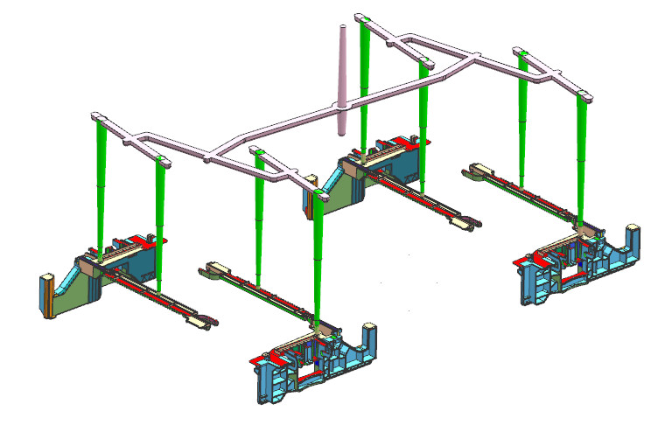
II. Typical Ideas
Runner-Less
Runner
Part

Slide 12
Thank you!

Slide 13
II. Typical Ideas
CD Monthly progress

Slide 14
II. Typical Ideas
Runner-Less

